Slide 1

AI/ML Bootcamp 2023
school.wakehealth.edu/wfbmi @WFBMI

Slide 2
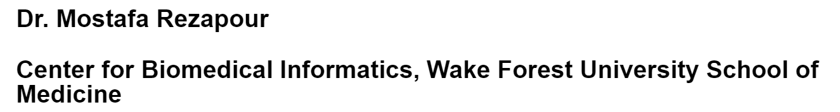
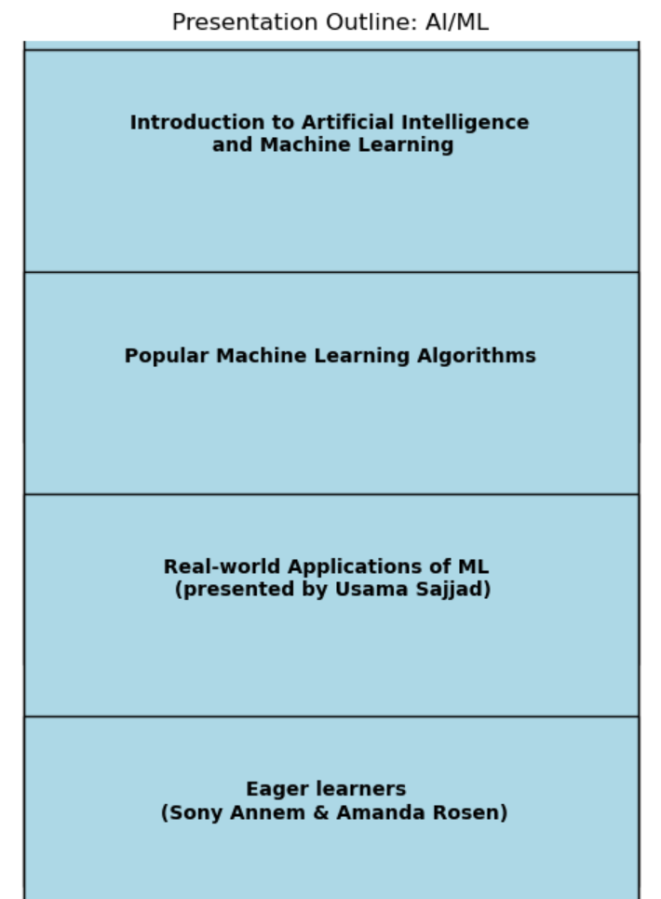
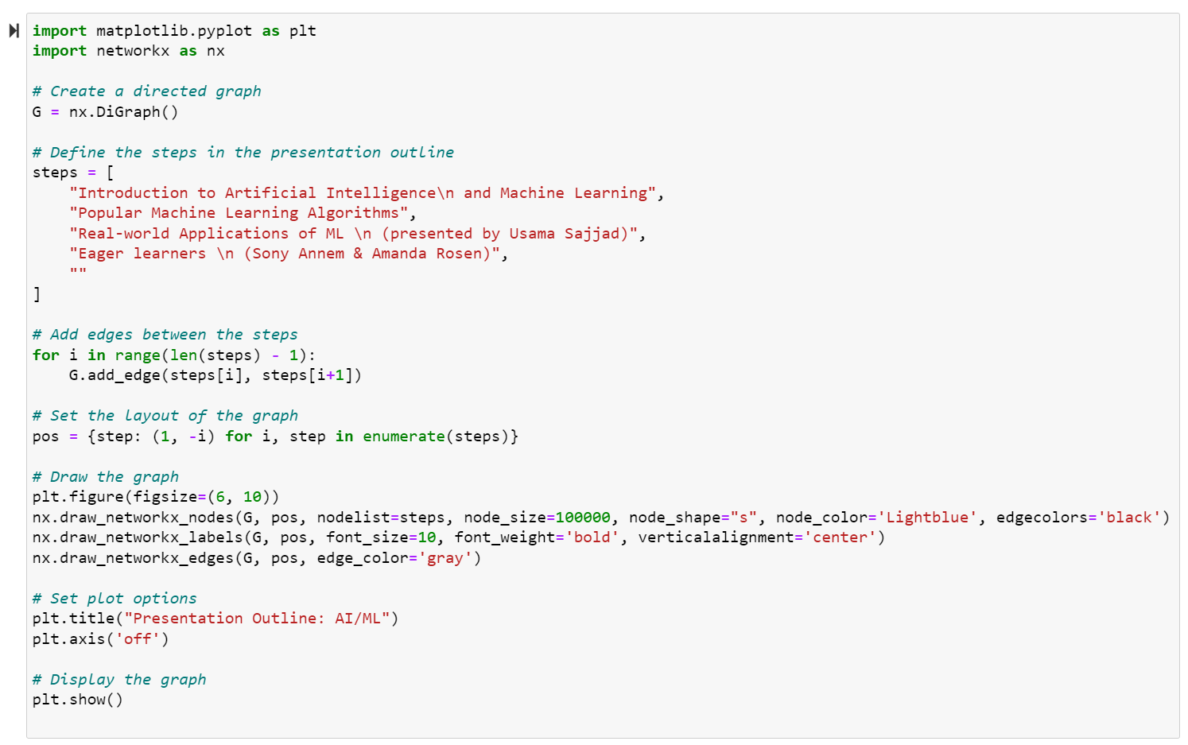
Outline:

Slide 3
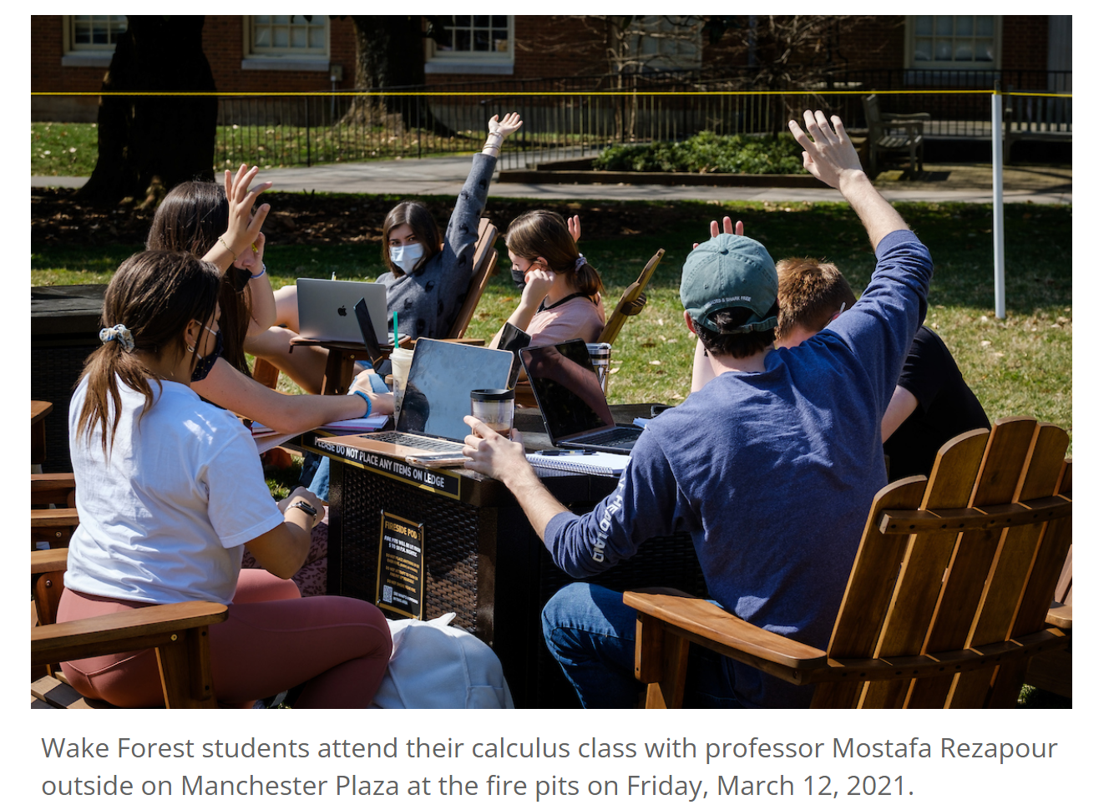
Your Questions Matter! Please Ask.
https://cat.wfu.edu/2023/03/nontraditional-learning-spaces-on-campus/

Slide 4
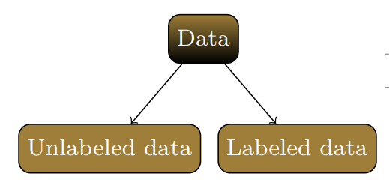
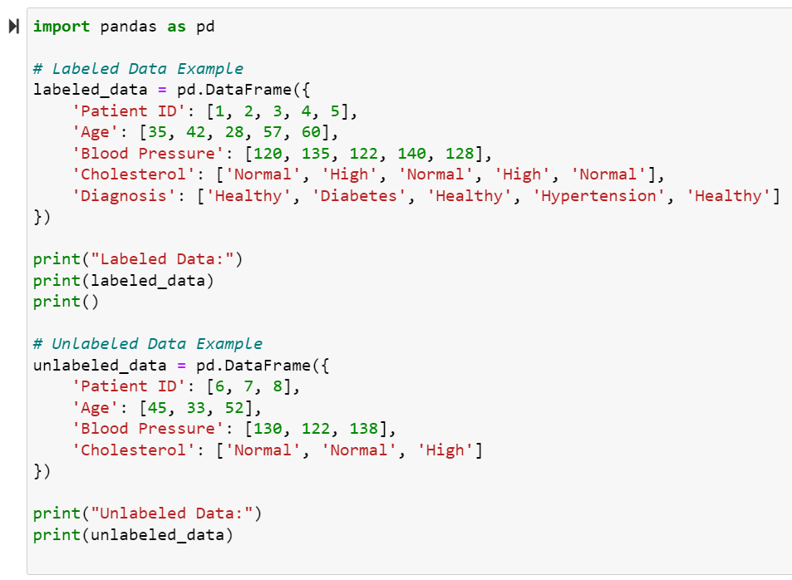
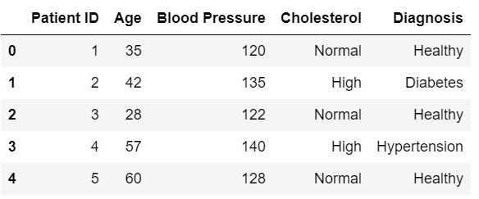
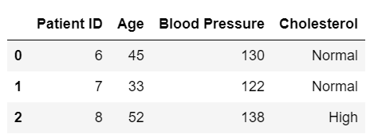
Labeled vs Unlabeled Data:

Slide 5
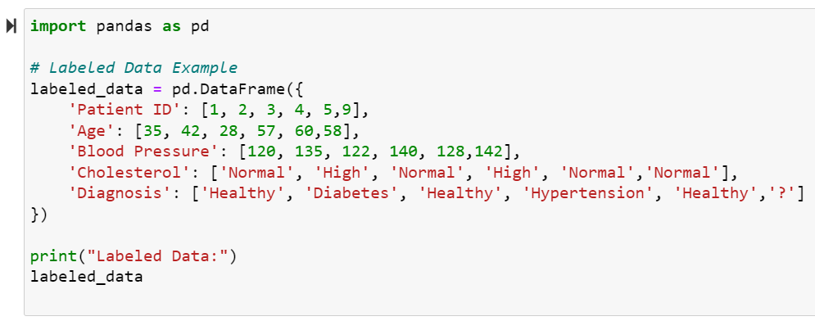
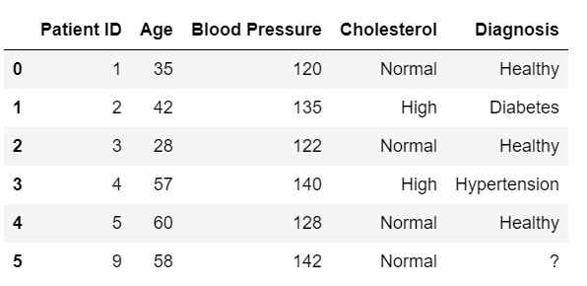
Labeled vs Unlabeled Data:

Slide 6
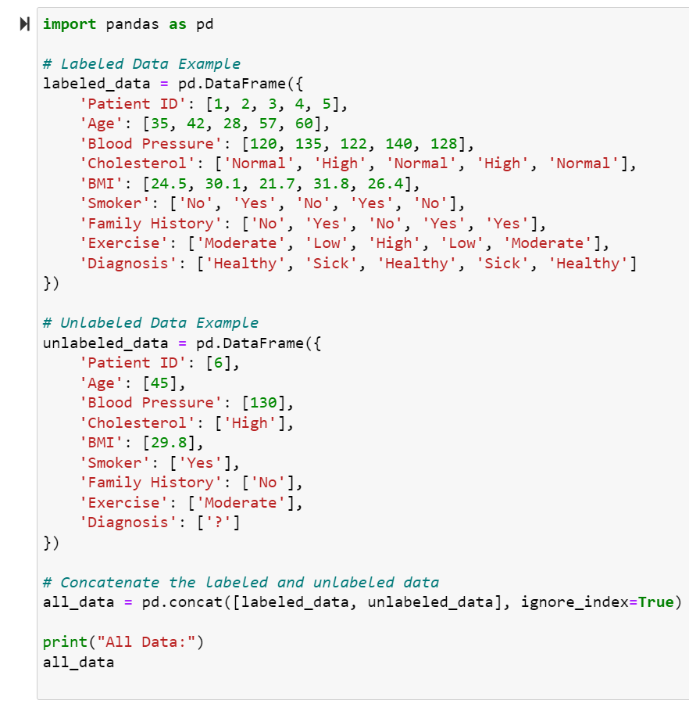
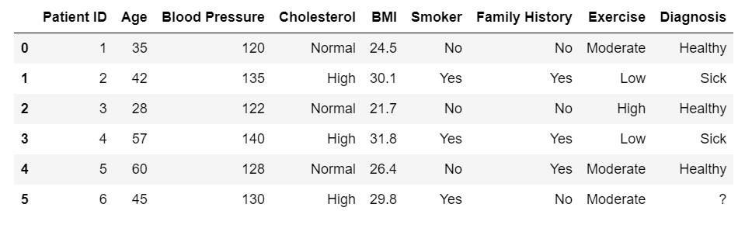

Slide 7
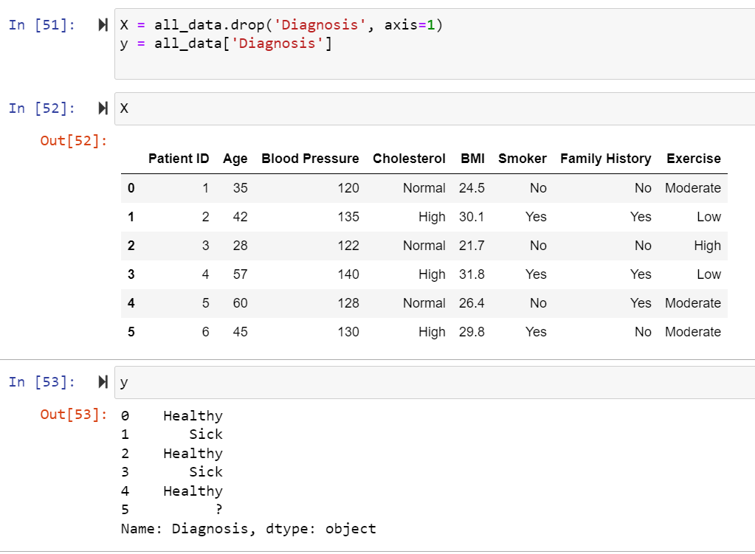
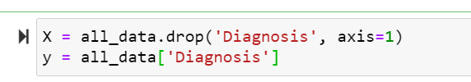
Split the data into features (X) and the target variable (y). In this case, the features will be all the columns except 'Diagnosis', and the target variable will be 'Diagnosis'.

Slide 8
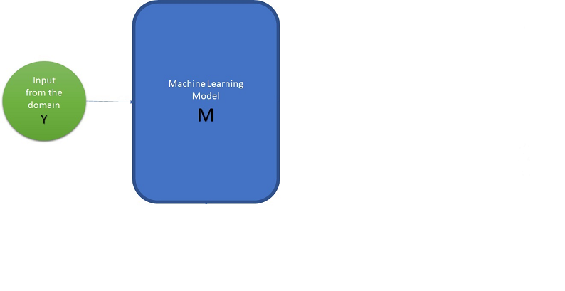

Slide 9
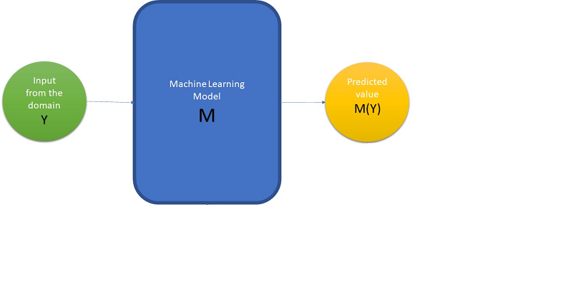

Slide 10
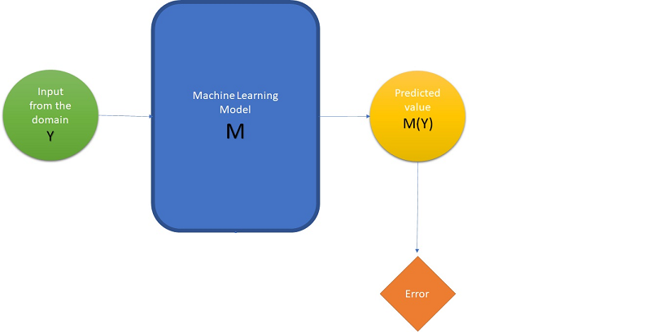

Slide 11
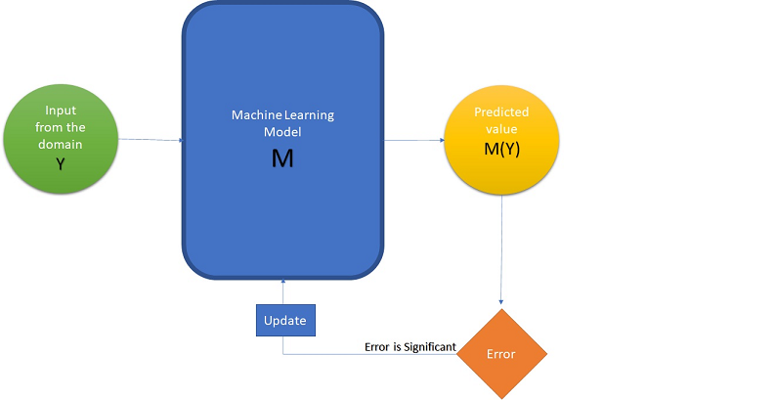

Slide 12
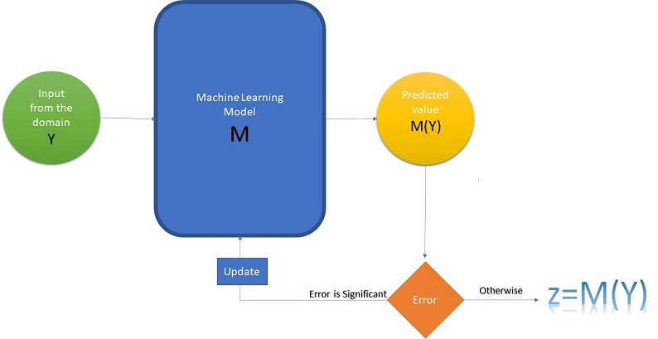

Slide 13
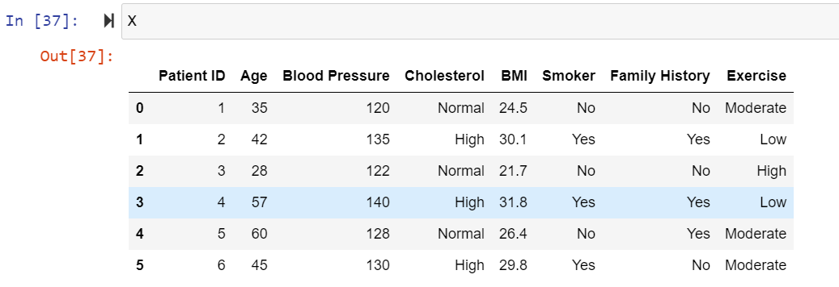
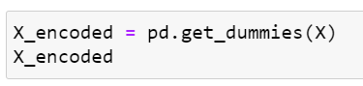
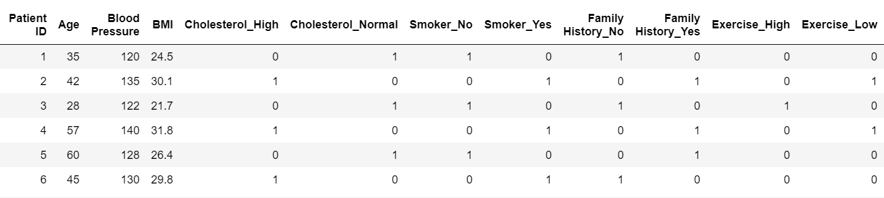
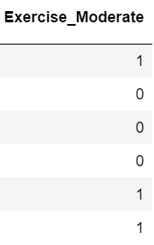
Categorical variables:
Encode categorical variables using one-hot encoding. This step is necessary to convert categorical variables into a numerical format that the machine learning model can understand.

Slide 14
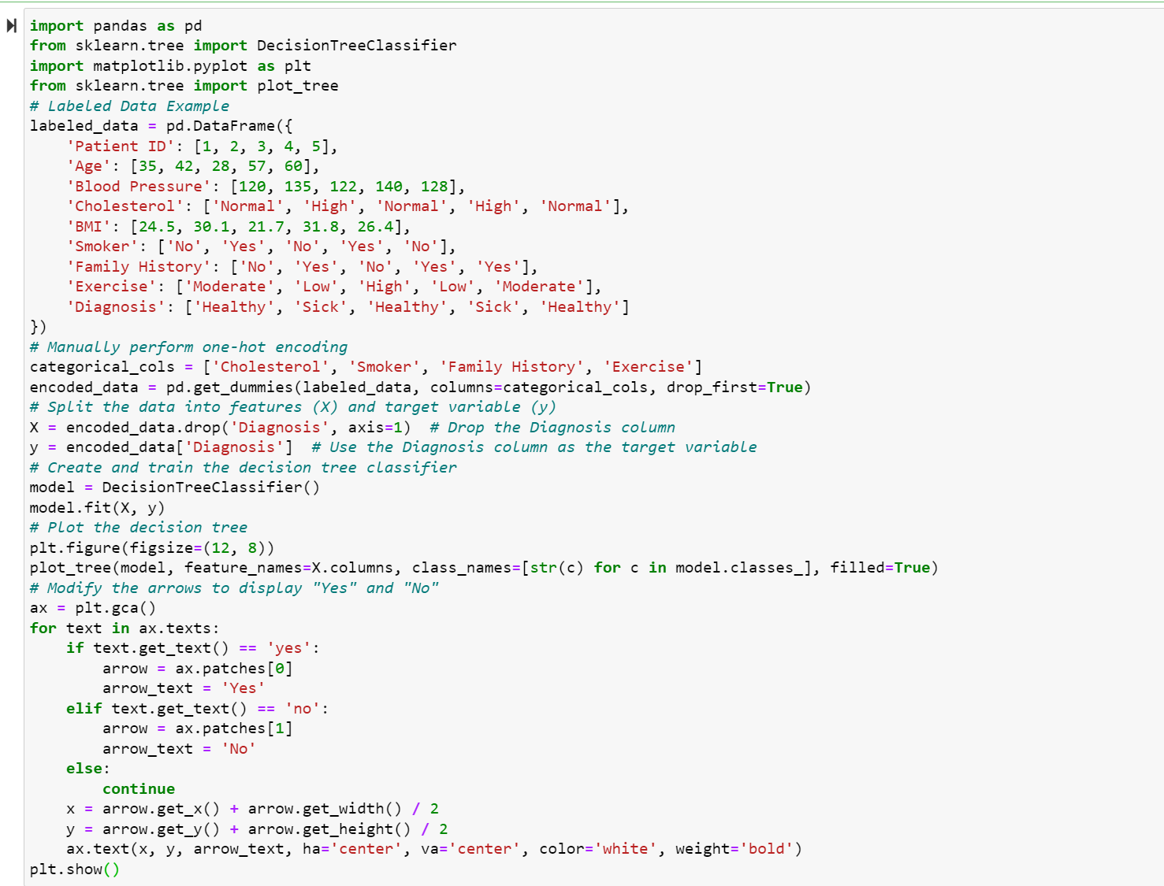
Decision Tree Classifier:

Slide 15
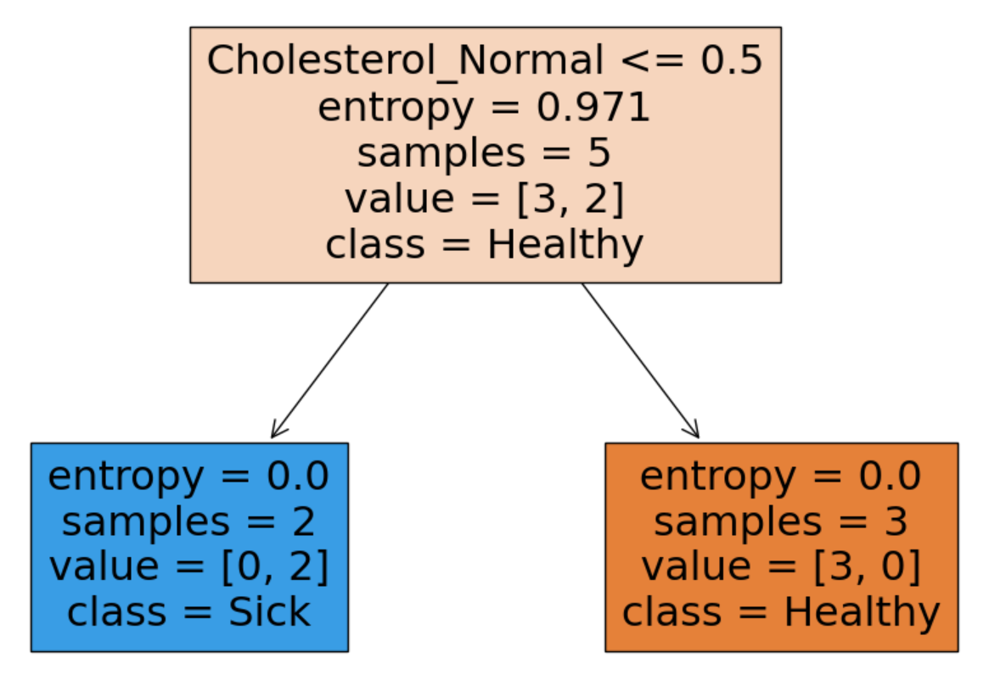
Decision Tree Classifier:

Slide 16
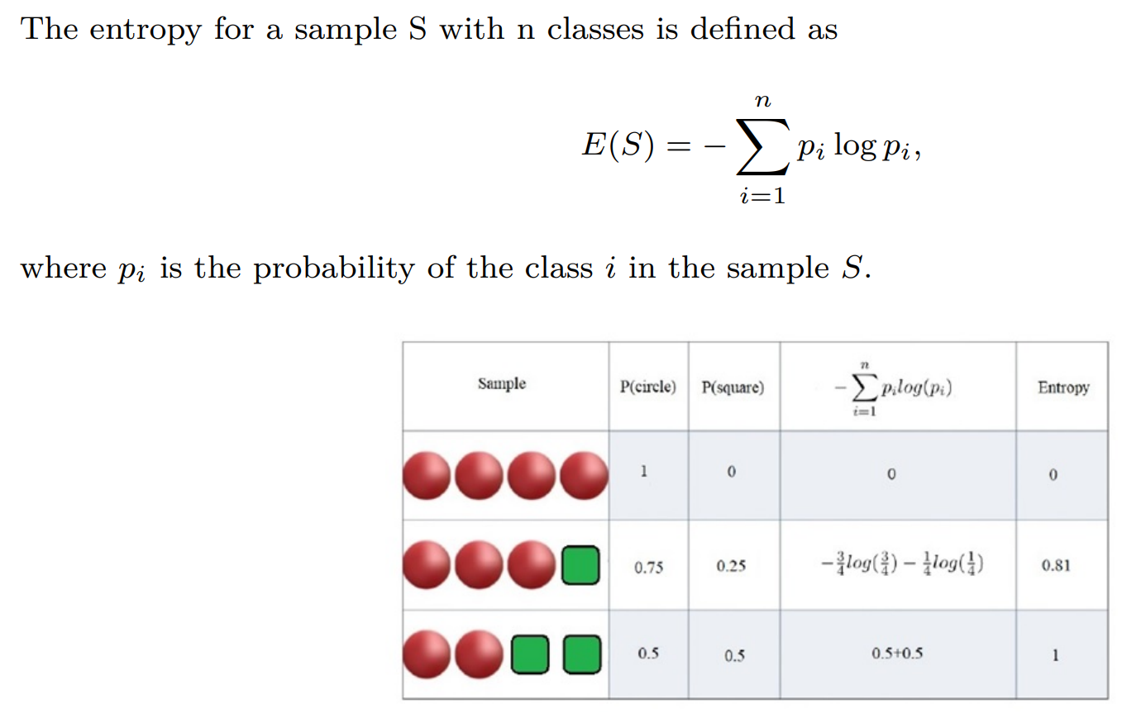
Entropy:

Slide 17
Decision Tree Classifier:

Slide 18
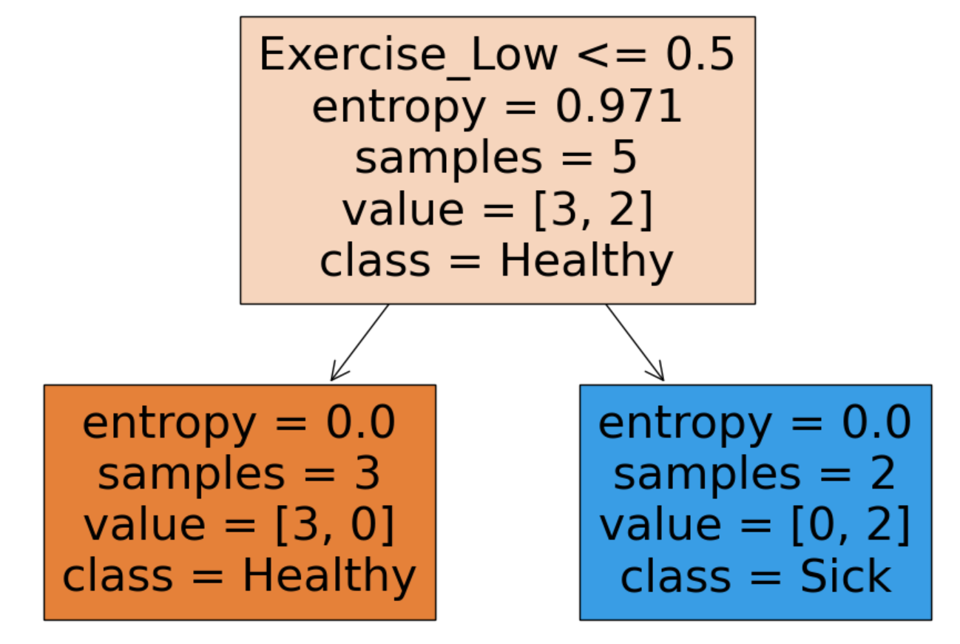
Decision Tree Classifier:

Slide 19
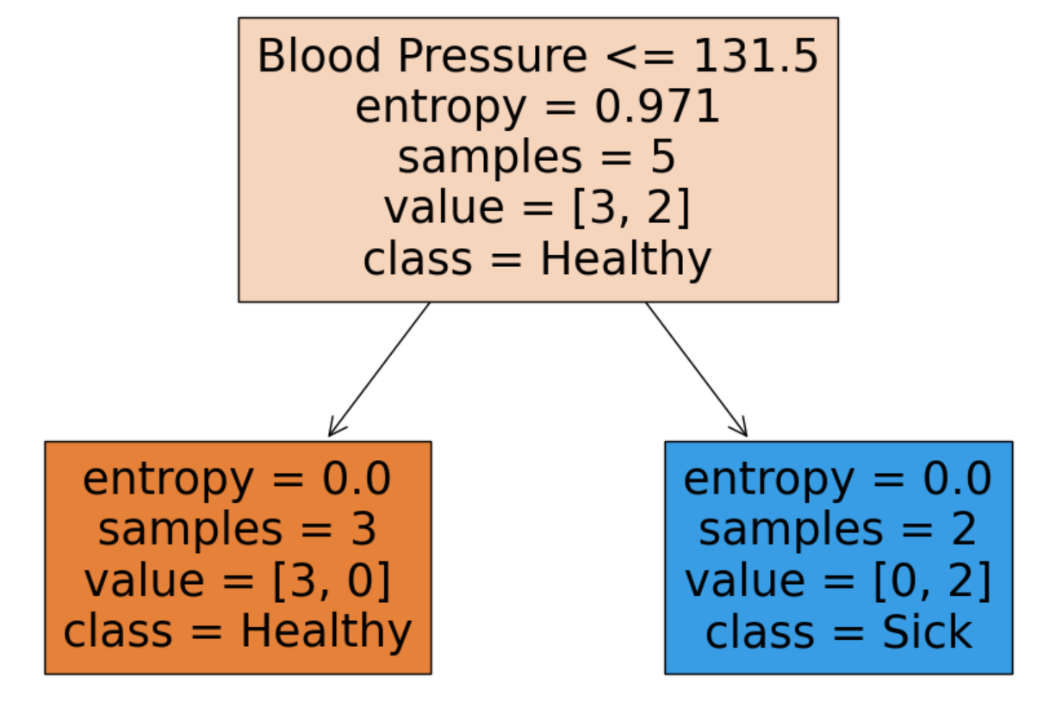
Decision Tree Classifier:

Slide 20
Decision Tree Classifier:
What is your prediction?

Slide 21
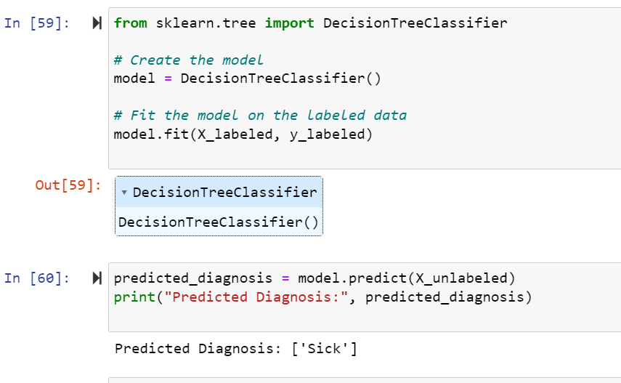
Decision Tree Classifier:

Slide 22
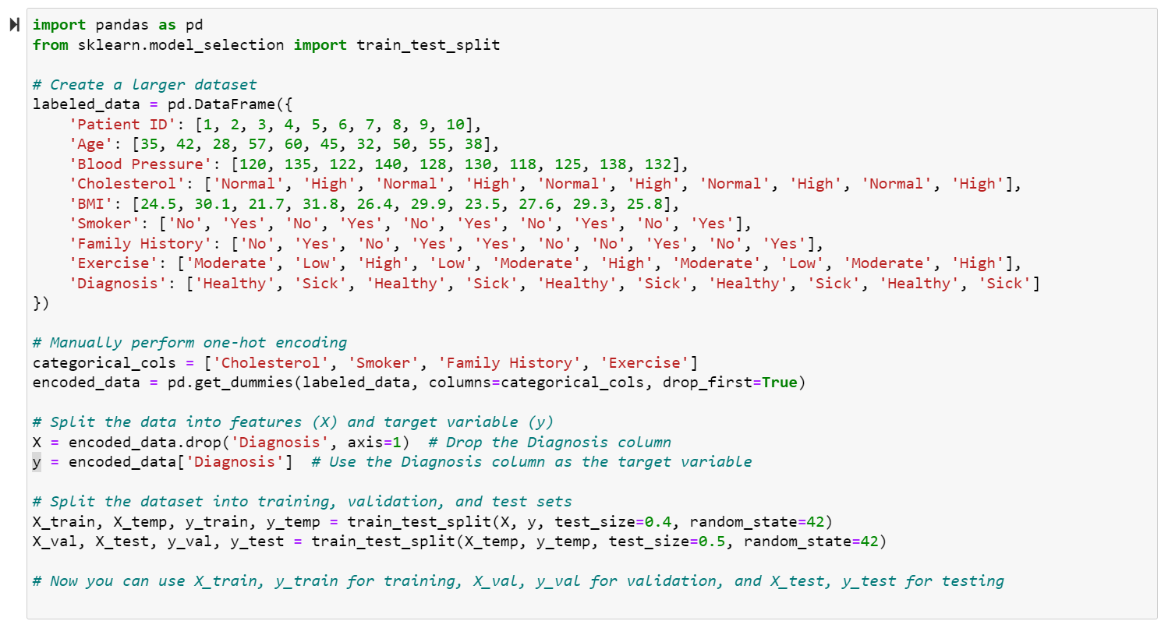
Training-validation-test split:
Example of creating a larger dataset and splitting it into training, validation, and test sets:

Slide 23
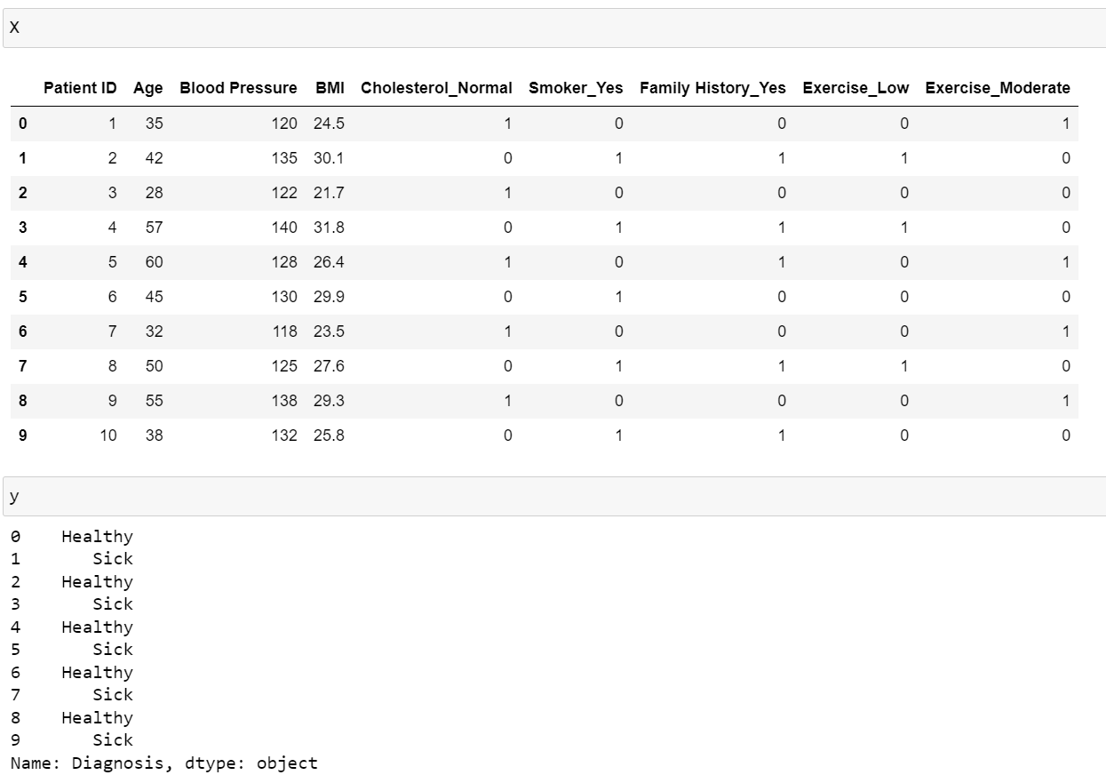
Training-validation-test split:
Example of creating a larger dataset and splitting it into training, validation, and test sets:

Slide 24
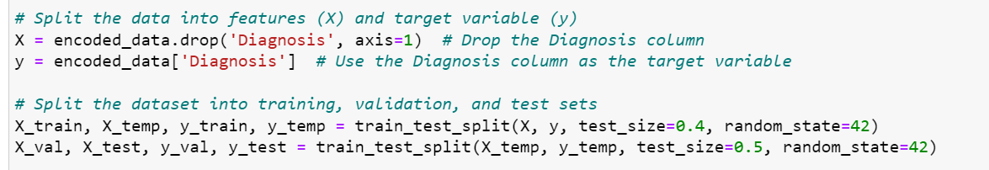
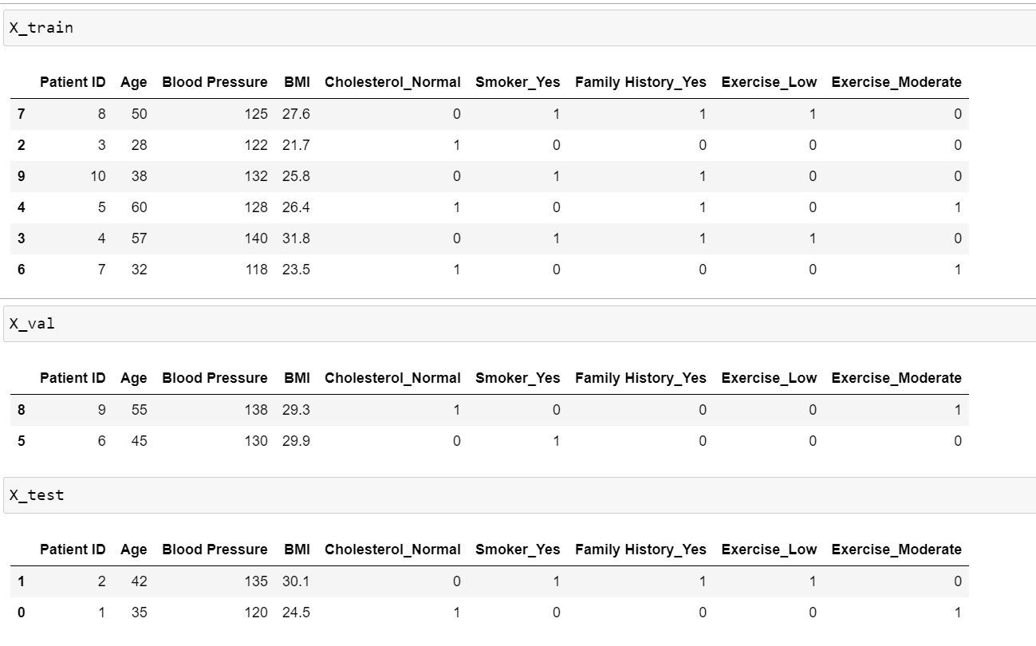
Training-validation-test split:

Slide 25
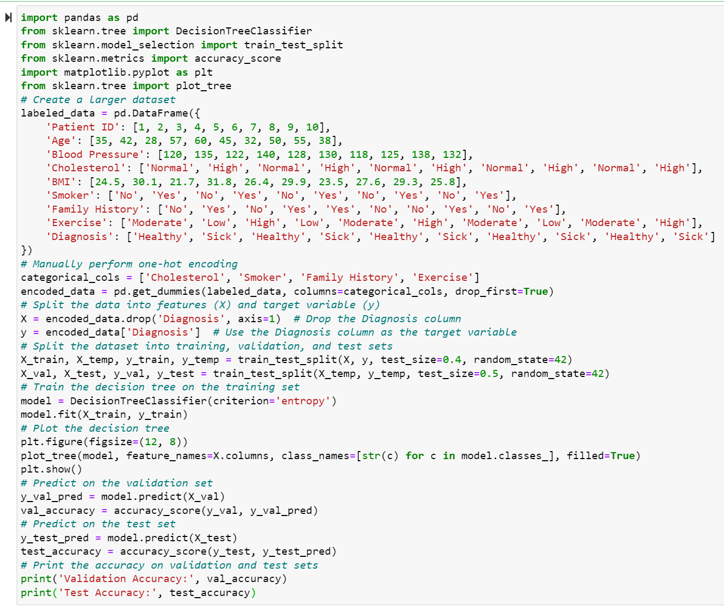
Training-validation-test split- Decision Tree:

Slide 26
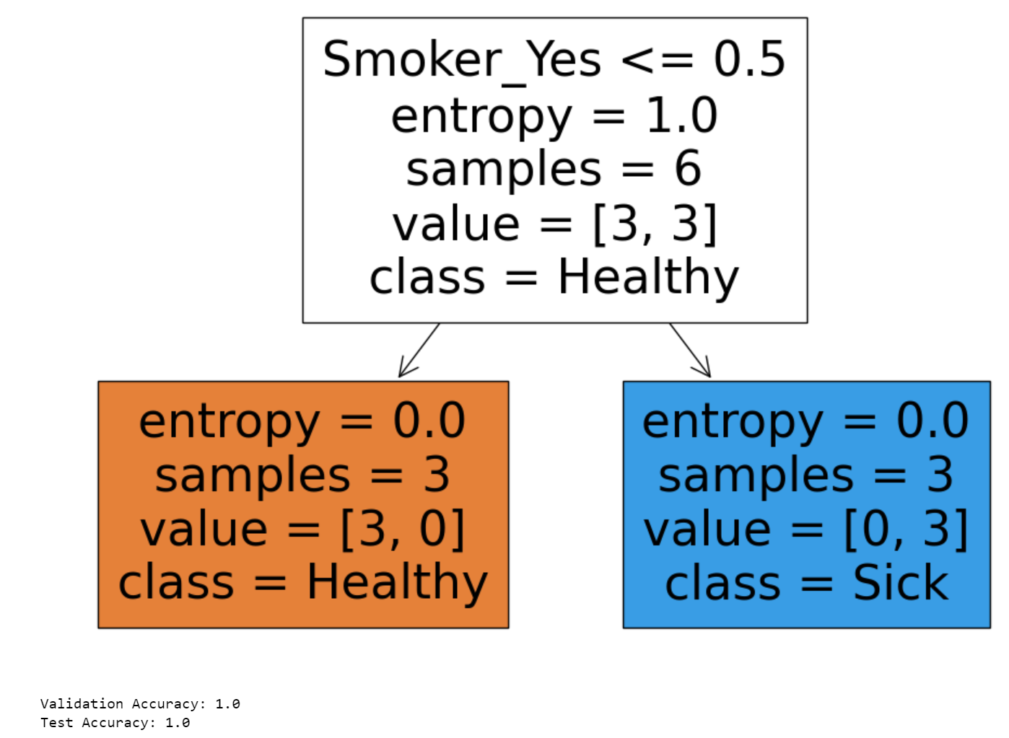
Training-validation-test split- Decision Tree:

Slide 27
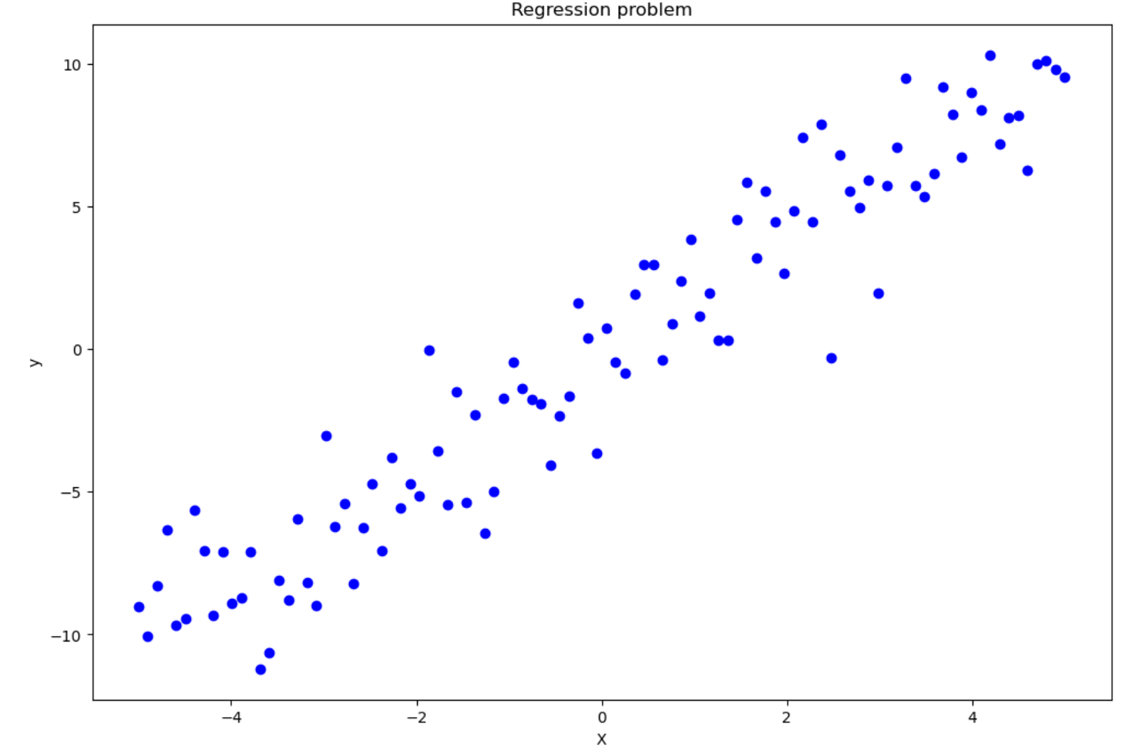
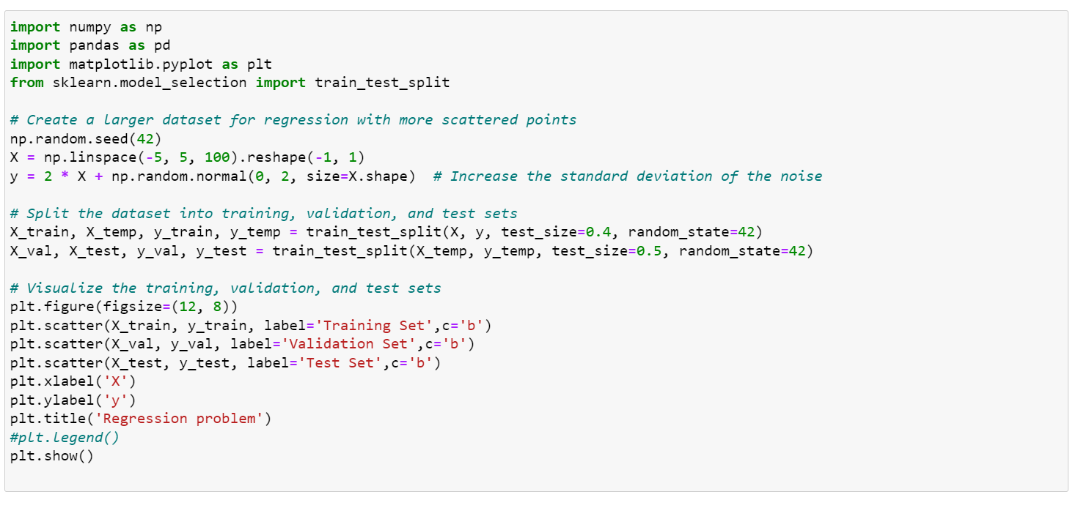
Regression:

Slide 28
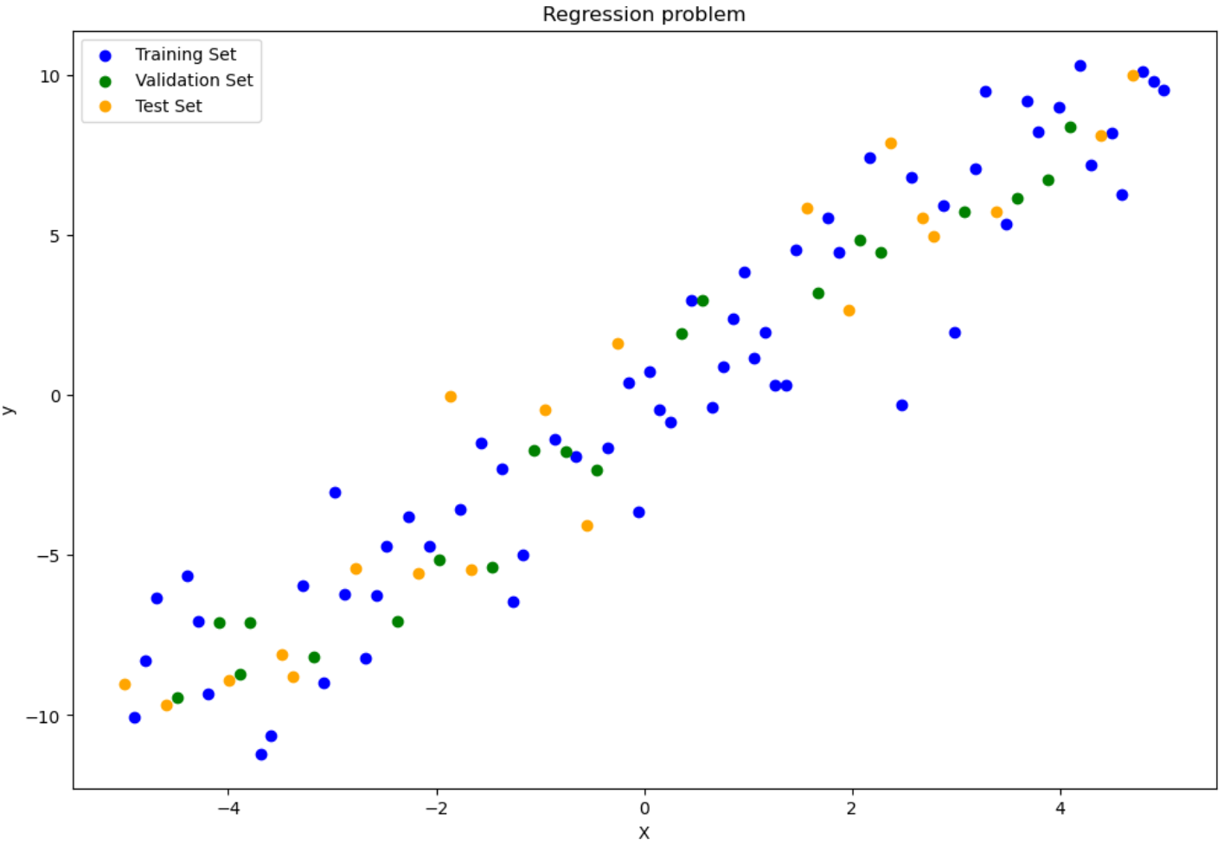
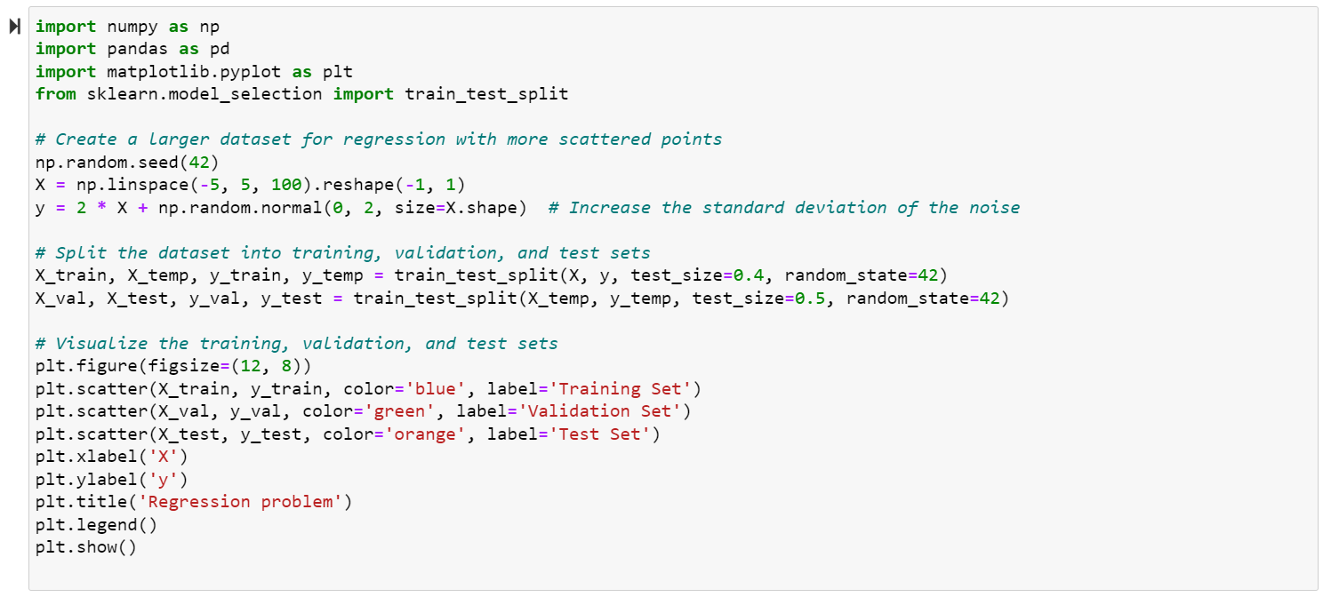
Training-validation-test split- Regression:

Slide 29
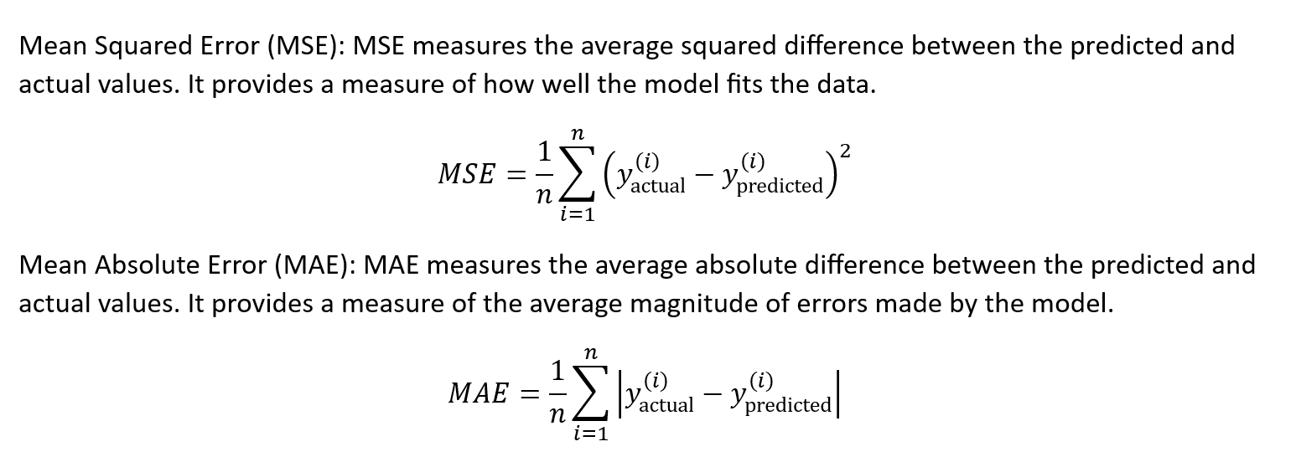
Loss function:

Slide 30
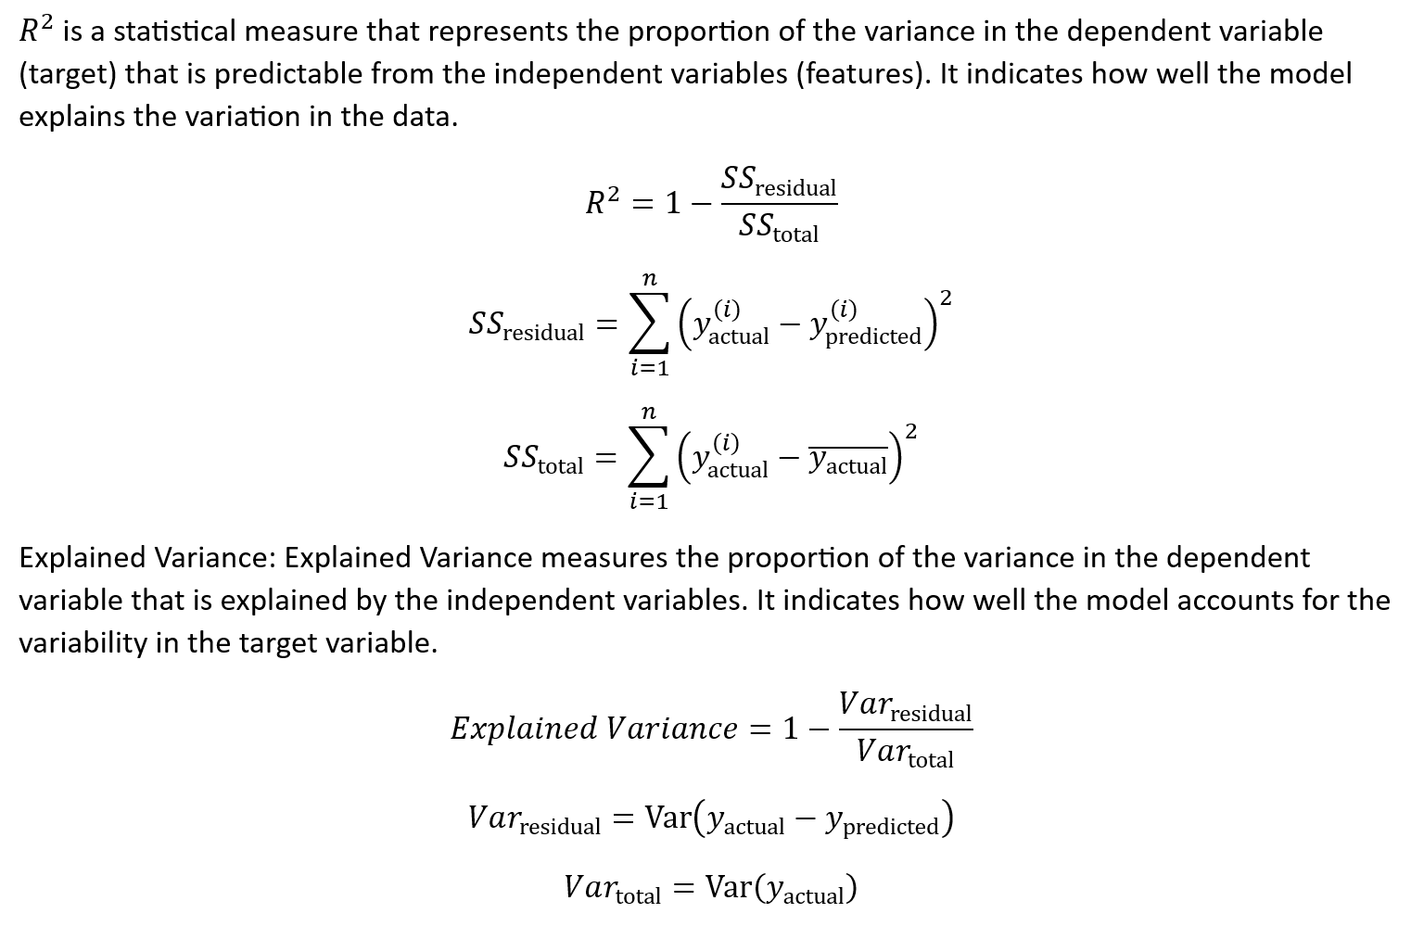
Other metrics:

Slide 31
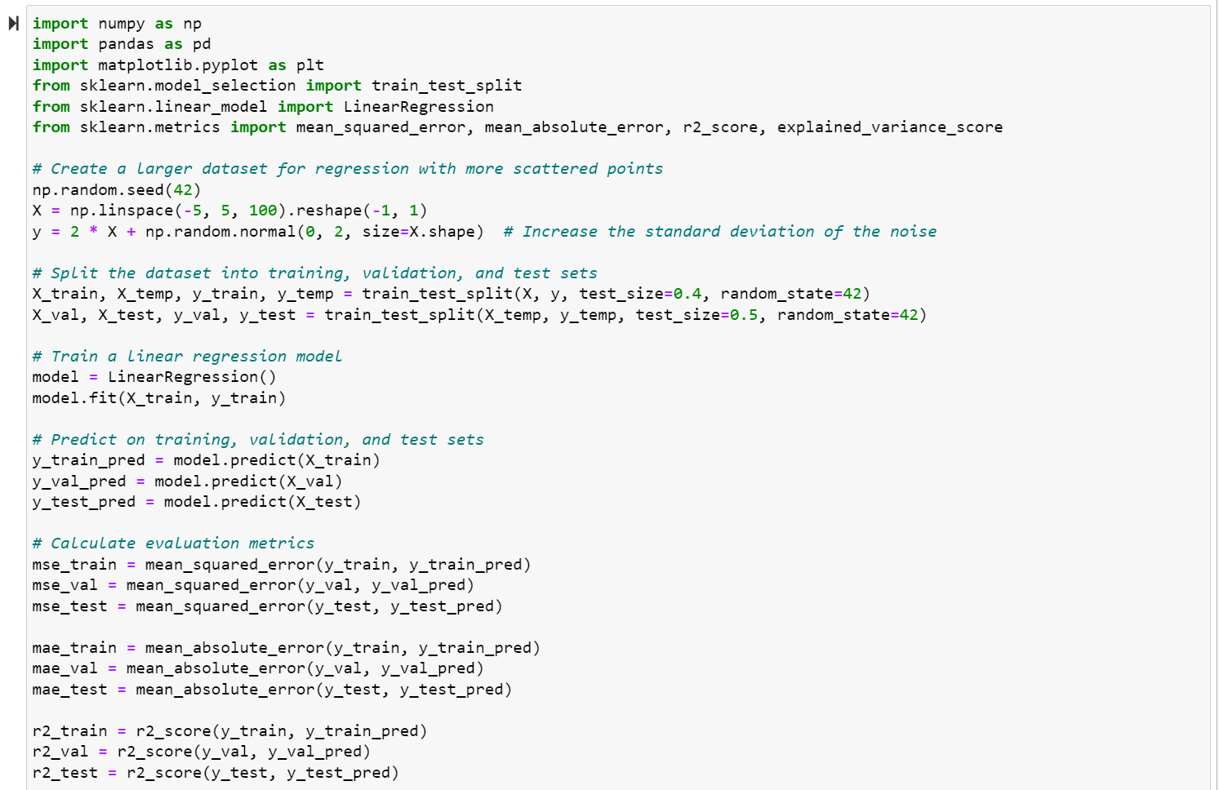
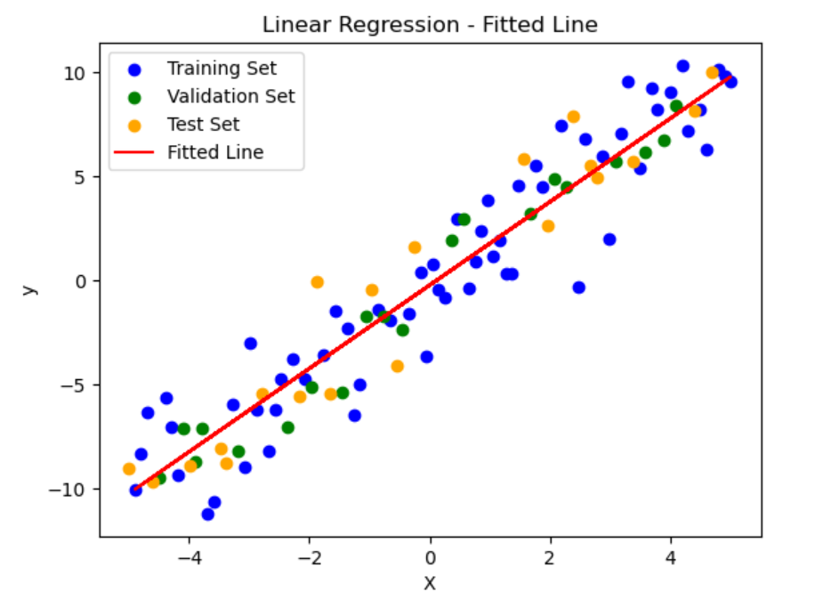
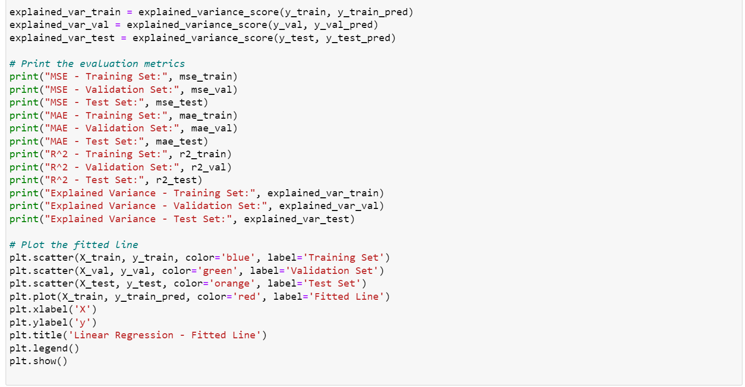
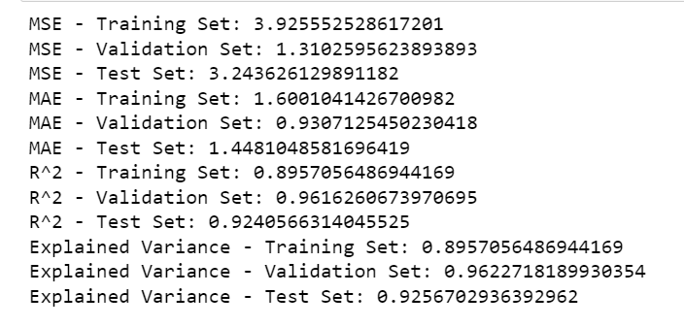

Slide 32
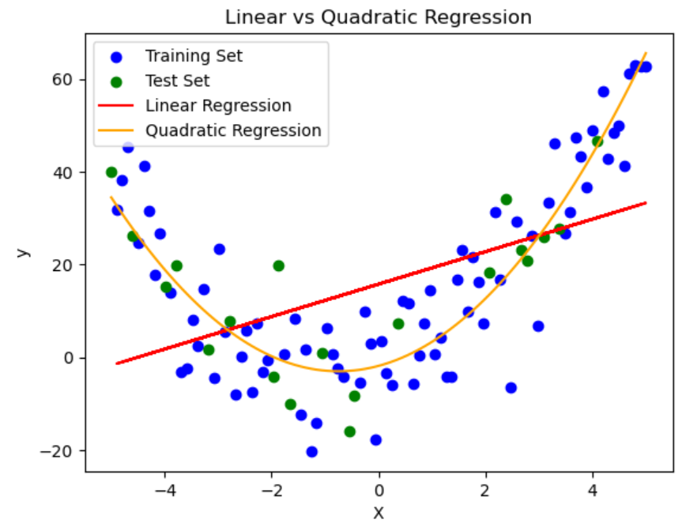
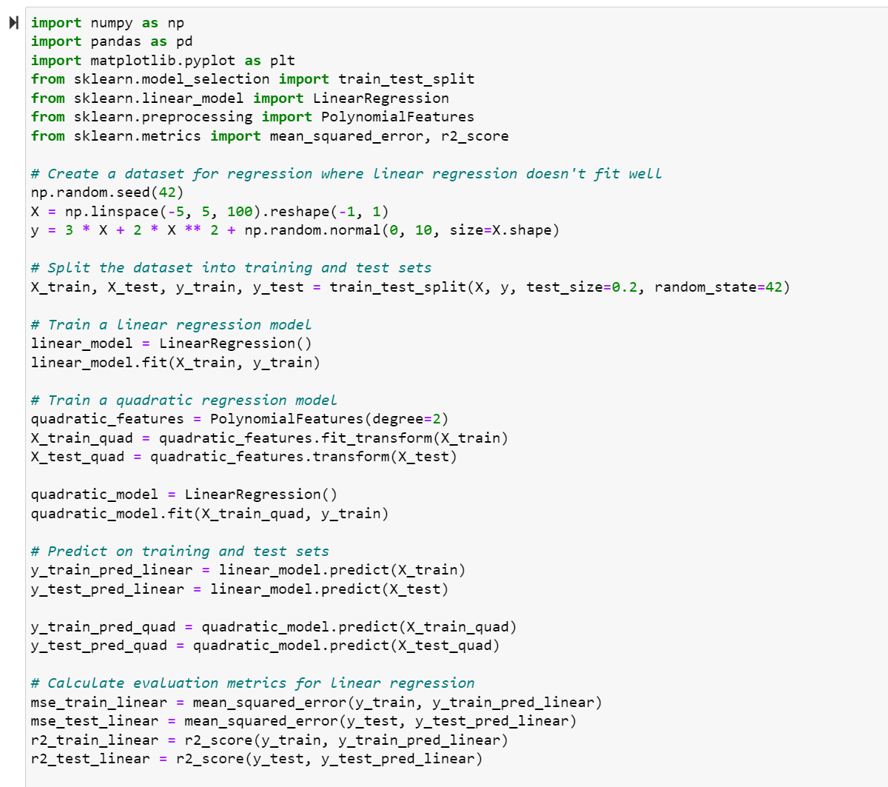
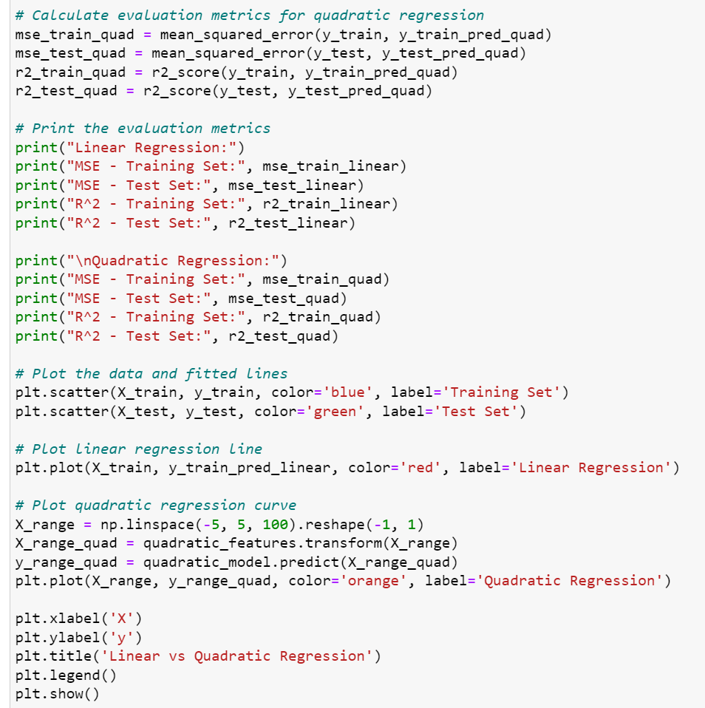
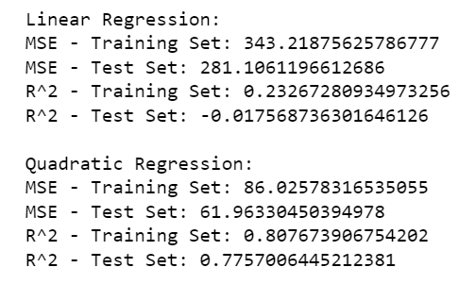

Slide 33
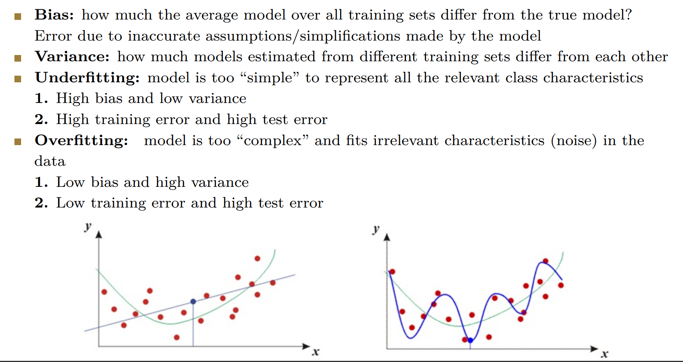

Slide 34


The Breast Cancer Wisconsin (Diagnostic) dataset

Slide 35


Tunning Hyperparameters on Validation set:

Slide 36

Training-validation-test split- Decision Tree:

Slide 37


Slide 38

Training-validation-test split- Decision Tree:

Slide 39


AUC stands for Area Under the ROC Curve. It is a commonly used metric for evaluating the performance of binary classification models. The ROC curve (Receiver Operating Characteristic curve) is a graphical representation of the model's performance across various classification thresholds.

Slide 40
AUC is a good metric for several reasons:
It is insensitive to class imbalance: AUC is unaffected by the imbalance in the distribution of positive and negative examples in the dataset. This makes it a suitable metric when dealing with imbalanced datasets.
It is robust to changes in the decision threshold: AUC measures the model's performance across all possible decision thresholds, making it less sensitive to the specific threshold chosen for classification.
It measures the overall ranking quality: AUC takes into account the model's ability to correctly rank examples, rather than just the accuracy of individual predictions. It provides a holistic view of the model's discriminatory power.

Slide 41



Cross-validation:
https://commons.wikimedia.org/wiki/File:KfoldCV.gif

Slide 42


The Iris dataset:
Used for classification tasks and benchmarking different algorithms.
Contains measurements of four features of Iris flowers: sepal length, sepal width, petal length, and petal width.
Consists of three different species of Iris flowers: setosa, versicolor, and virginica.
Each species has 50 samples, making a total of 150 samples in the dataset.
Each sample is represented by a row of data with the four feature measurements.
Goal is typically to classify or predict the species of an Iris flower based on its feature measurements.

Slide 43


Support Vector Machines (SVM):
SVM aims to find the best hyperplane that separates the data points of different classes with the largest possible margin.
It is a binary classification algorithm but can be extended to handle multi-class classification problems.
SVM works by mapping the input data into a higher-dimensional feature space and finding an optimal hyperplane that maximally separates the classes.
The points closest to the hyperplane are called support vectors, which are crucial in defining the decision boundary.
SVM can handle both linearly separable and non-linearly separable data through the use of different kernel functions.
Common kernel functions include linear, polynomial, and radial basis function (RBF).
https://gfycat.com/gifs/search/svm
https://torchbearer.readthedocs.io/en/0.1.7/examples/svm_linear.html

Slide 44


SVM-OVO:

Slide 45



Slide 46



Slide 47


Slide 48


Slide 49


Slide 50


Slide 51


Slide 52


Slide 53


Slide 54


Slide 55


Slide 56


Slide 57


Slide 58


Slide 59


Slide 60


Slide 61


Slide 62


Slide 63

Rezapour M, Niazi MKK, Gurcan MN. Machine learning-based analytics of the impact of the Covid-19 pandemic on alcohol consumption habit changes among United States healthcare workers. Sci Rep. 2023 Apr 12;13(1):6003. doi: 10.1038/s41598-023-33222-y. Erratum in: Sci Rep. 2023 Apr 26;13(1):6818. PMID: 37046069; PMCID: PMC10092930.

Slide 65
Real world Application of ML

Slide 66

Solving a Machine Learning problem

Slide 67

Problem: Predict the price of Houses

Slide 68
Sources of Data
Scraping from Internet Source
Sources of Data
Personal Databases
Publicly available repositories

Slide 69
Example: Overview of Housing Dataset
Consists of 14 features i.e., crime rate, proportion of businesses, distance to major centers, age.
Target Variable: median value of owner-occupied homes in $1000s.
Features | Description
ZN | proportion of residential land zoned for lots over 25,000 sq.ft.
INDUS | proportion of non-retail business acres per town
CHAS | Distance to Charles River
NOX | nitric oxides concentration
RM | average number of rooms per dwelling
AGE | proportion of owner-occupied units built prior to 1940

Slide 70
Dataset Features
Features | Description
DIS | weighted distances to ﬁve Boston employment centers
RAD | index of accessibility to radial highways
TAX | full-value property-tax rate per $10,000
PTRATIO | pupil-teacher ratio by town
LSTAT | lower status of the population
MEDV | Median value of owner-occupied homes in $1000s

Slide 71

Skewness
Measurement of the distortion of symmetrical distribution or asymmetry in a attributes.
Extreme cases can act as an outlier.
Log1p transformation

Slide 72

Training, and Testing sets generation
Evaluation process that allows you to simulate how your model performs on new/unseen data.
Split ratio: 70:15:15.

Slide 73

Data Normalization
The attributes TAX, CRIM are generally considered as equally important, but their scales are different and TAX might take higher priority over other attributes

Slide 74




Importance of Data Normalization
Before Normalization
After Normalization
$$R_{12 }=31.0004$$
$$R_{13 }=12.0001$$
$$R_{12 }=1.024$$
$$R_{13 }=1.073$$

Slide 75


Data Normalization Methods
Min-max Normalization
Z-score Normalization

Slide 76

Min-Max Normalization

Slide 77
Data Cleaning
Remove the rows
Handling Missing Values
Imputation using Nearest Neighbors !
Mean, Median, Mode

Slide 78

Data Cleaning
Delete the Row!
Impute the missing values!

Slide 79

Data Cleaning

Slide 80


Pearson Correlation
Statistical tool that helps to measure the degree of relationship between two variables.
It deals with the association between two or more variables.

Slide 81

Correlation Matrix

Slide 82

Performance of Linear Regression on Validation set

Slide 83

Performance of Linear Regression on Test set

Slide 84
Presentation on
Segment Anything Model (SAM)
Presenters: Sony Annem and Amanda Rosen
Under the Guidance of: Dr. Khalid Niazi, Dr. Mostafa Rezapour, Ziyu Su, and Usama Sajjad.

Slide 85

What is Segmentation & Why ?
Image segmentation is a computer vision task that involves dividing an image into multiple segments or regions based on certain characteristics or criteria.
Segmentate results on bone marrow cells affected by leukemia
The goal of image segmentation is to partition an image into meaningful and visually distinct regions, allowing for easier analysis and understanding of the image's content.

Slide 86
Popular Segmentation methods
Threshold Method : we will set a particular threshold value
Edge Based Segmentation : an edge filter is applied on the images
Region Based Segmentation : groups pixels in an image into regions based on certain criteria, such as color, texture, or other image properties.
Clustering Based Segmentation : image regions into clusters based on their similarity in some feature space.
Artificial Neural Network Based Segmentation: utilizes neural networks, particularly convolutional neural networks (CNNs). [U-Net, Fully Convolutional Networks (FCN), and Mask R-CNN.]

Slide 87

Introducing SAM from Meta[in April 2023]
Meta AI came with an idea of using foundational model for image segmentation what is called Zero Shot learning with prompting instead of re-training for the new task. This work aims to leverage the SAM to solve specific downstream image segmentation tasks.

Slide 88

SAM Model Training(they aiming to achieve foundational model rather than segmentation model)
They created a Data Engine to train the model with over 1 billion masks on 11M licensed and privacy respecting images.
1. Assisted-Manual Stage
2. Semi-automatic stage
3. Fully automatic stage
This masks are fully automatically generated using SAM model, named it as SA -1B dataset (publicly available).

Slide 89

SAM Model

Slide 90


Image Encoder
They used a Pretrained Masked AutoEncoder Vision Transformers model in order to create embeddings.

Slide 91

Prompting in segmentation

Slide 92


Mask Decoder
By collecting the image embedding and prompts, Mask decoder implement the segmentation on the required prompt, it also uses modified transformer decoder and returns the image to original size with mask.
original Image Segmented results using SAM
SAM

Slide 93

Overview of Model Architecture

Slide 94
SAM Results on histopathology images using Box prompts experimental findings suggest that SAM may fail or perform poorly in certain segmentation tasks.

Slide 95




Slide 96




Slide 97


IOU Intersection Over Union is essentially a method to quantify the percent overlap between the target mask and our prediction output. We got average of those IOU scores as 0.7, which was pretty good, but our goal is to improve around 0.9.

Slide 98



Slide 99
Does SAM Fails to Segment Anything?
Paper : SAM Fails to Segment Anything? – SAM-Adapter:
Adapting SAM in Underperformed Scenes:
Camouflage, Shadow, Medical Image Segmentation,
and More

Slide 100

SAM-Adapter: Adapting SAM in Underperformed Scenes:
SAM-Adapters work by introducing additional adapter modules into the original SAM (Segment Anything Model) architecture to incorporate domain-specific information.

Slide 101


Here:
Fi is task specific information.
MLPitune are linear layers used to generate task-specific prompts for each Adapter.
MLPup is an up-projection layer shared across all Adapters that adjusts the dimensions of transformer feature.
Pi refers to the output prompt that is attached to each transformer layer of SAM model. GELU is the activation function.

Slide 102

Task Specific Information
The task-specific knowledge Fi is learned and injected into the network via Adapters, it can be various forms depending on the task and flexibly designed. For example, it can be extracted from the given samples of the specific dataset of the task in some form, such as texture or frequency information.
F j can be one specific type of knowledge/features and w j is an adjustable weight.
In the paper Adapting SAM in Underperformed Scenes: Camouflage, Shadow, Medical Image Segmentation, they choose two types of visual knowledge, patch embedding and high frequency components and weights as 1.

Slide 103
Difference between SAM & SAM-Adapter

Slide 104
References
SAM by Meta.
https://segment-anything.com/
SAM Fails to Segment Anything? – SAM-Adapter: Adapting SAM in Underperformed Scenes: Camouflage, Shadow, Medical Image Segmentation, and More.
https://tianrun-chen.github.io/SAM-Adaptor/

Slide 105
Future Goals
Implementing SAM-Adapter on Histopathology Images
And also testing SAM and SAM-Adapter on different Dataset
Comparing SAM & SAM-Adapter Results

Slide 106
Thank you !

Slide 107
References
[1] https://developer.nvidia.com/blog/automatically-segmenting-brain-tumors-with-ai/
[2] https://www.educba.com/what-is-supervised-learning/
[3] https://mdpi.com/1424-8220/23/6/3080
[4] https://www.slideshare.net/dessybudiyanti/simple-linier-regression?from_action=save

